Slide 1

Measuring & Valuing ESG Impacts
Brian Werner
Associate Director
Trucost, a part of S&P Dow Jones Indices
Copyright © 2017 by S&P Global.
All rights reserved.

Slide 2
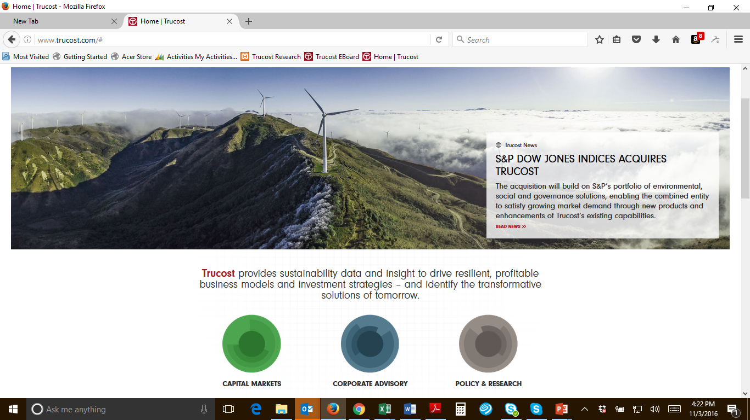
About Trucost

Slide 3











Trucost ESG Solutions
Trucost provides sustainability data and insight to drive resilient, profitable business models and investment strategies – and identify transformative solutions of tomorrow
Investor Portfolios & Bank Loan books
New Business Models
Corporate supply chains
Commodities
Net benefit of new products or technologies
ESG analytics and data for footprinting, target setting, shadow pricing, scenario analysis, positive impact assessment
500+ environmental metrics in six major categories
17 years Trucost has been researching, standardizing and validating the world’s most comprehensive natural capital data
93% coverage of global equity markets by market cap.
10,000 companies and their supply chains researched annually by Trucost analysts
$20 T in investment funds analyzed
Greenhouse Gases
Air Pollutants
Water
Land and Water Pollutants
Waste
Natural Resource Usage

Slide 4


Sustainable Investing: Interconnected Issues
Governance, Ethics, and
Policy
•Ownership structure and board composition
•Risk management oversight
•Supply chain management oversight
•Shareholder value and protection
•Changing regulation
Climate Change
•Volatile weather
•Increased insurance premiums
•Physical asset damage
•Adaptation costs
Resource Scarcity
•Operational disruption
•Resource rationing
•Commodity price volatility
•Replacement costs
•Unconventional sourcing
Product Safety
•Product quality maintenance
•Litigation
•Privacy, data security
•Warranty and Recalls
Pollution and Waste
•Litigation
•Health costs
•Particulate, toxic cleanup costs
•Potable and arable resource destruction
•Compliance costs and effects
•Brand protection
Labor and Human Capital
•Skill shortages and staff turnover
•Precarious working conditions
•Demographic shifts
•Rising labor costs and standards
•Human and labour rights risks
•Loss of productivity and efficiency
Source: S&P Dow Jones Indices. For illustrative purposes only. Permission to reprint or distribute any content from this presentation requires the written approval of S&P Dow Jones Indices.

Slide 5
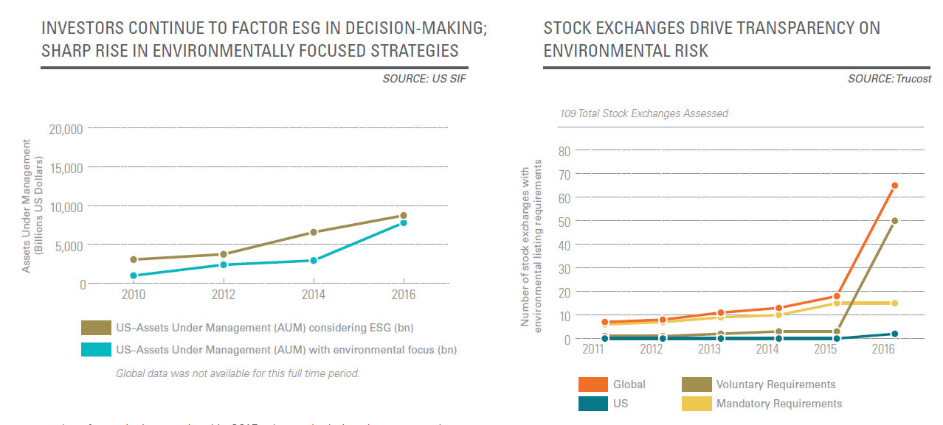
Investors Directing Capital to More Sustainable Business Models
Source: Trucost Analysis for State of Green Business Report, 2017 https://www.trucost.com/publication/the-state-of-green-business-2017/

Slide 6
S&P 500 Environmental & Socially Responsible Index
Overview
 | S&P 500 TR | S&P 500 E&S TR
Annualized Return (%)
1-YR Return | 11.96 | 11.82
3-YR Return | 8.87 | 9.17
5-YR Return | 14.66 | 14.95
Annualized Risk (%)
1-YR Risk | 10.29 | 10.67
3-YR Risk | 10.74 | 11.01
5-YR Risk | 10.37 | 10.46
Tracking Error (%)
1 Year |  | 1.16
3 Year |  | 1.34
5 Year |  | 1.33
•
Launched in May 2015 to address environmental and social challenges while maintaining close benchmark returns.
Excludes Fossil fuel, Tobacco, and Military Companies.
Eligible companies are ranked by E&S scores. The E&S score is the weighted average of scores from the Environmental and Social Dimensions of RobecoSAM’s CSA. Top 75% of the market cap is selected by E&S score
No. of constituents in the index: 284
•
•
•
Objective: investors who need benchmark hugging returns with an enhanced E&S exposure
5-Year Back-tested Historical Performance as of Dec 31, 2016
S&P 500 (TR) S&P 500 E&S Responsible Index (TR)
220
200
180
160
140
120
100
80
Total Return | Net Total Return | Price Return
USD | USD | USD
SPXESRT | SPXESRN | SPXESRP
Dec-11
Dec-12
Dec-13
Dec-14
Dec-15
Dec-16
Source: S&P Dow Jones Indices. Data as of December 31, 2016. Charts are provided for illustrative purposes. Past performance is no guarantee of future results. This chart may reflect hypothetical historical performance. Please see the Performance Disclosure at the end of this document for more
28
information regarding the inherent limitations associated with back-tested performance. Permission to reprint or distribute any content from this presentation requires the written approval of S&P Dow Jones Indices.

Slide 7


















SDG Sustainability Framework
17 Goals covering ESG themes mapped to S&P DJI’s Indices
Traditional ESG ESG + Impact / Sustainable Development Goals
Existing indices
Planned indices + ideas
Collaboration with Strategic ESG
partners and influencers
Source: S&P Dow Jones Indices. Permission to reprint or distribute any content from this presentation requires
the written approval of S&P Dow Jones Indices. For illustrative purposes only.
11

Slide 8
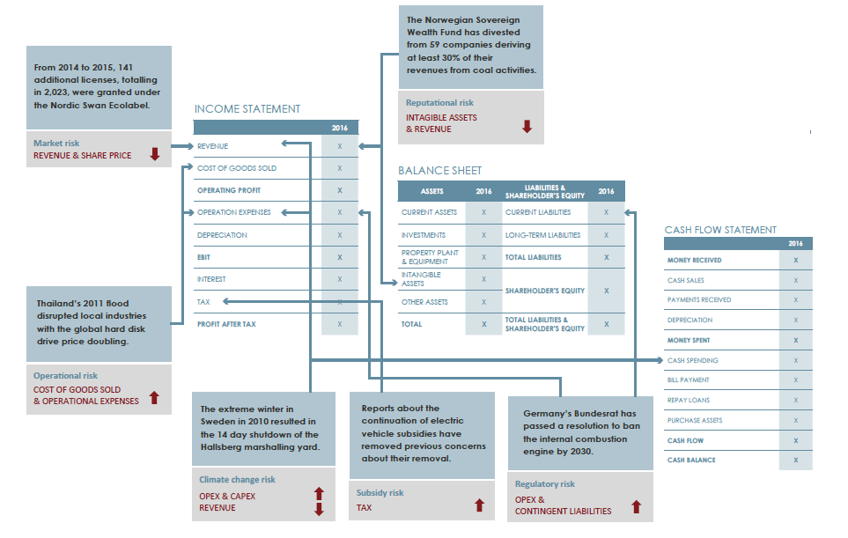
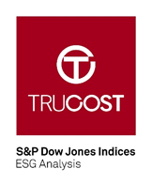
Translating ESG Issues into Financial Costs
Source: Trucost Analysis, Norwegian State Ownership of Companies Climate Risk https://www.trucost.com/publication/the-norwegian-states-direct-ownership-of-companies-climate-related-risks/

Slide 9
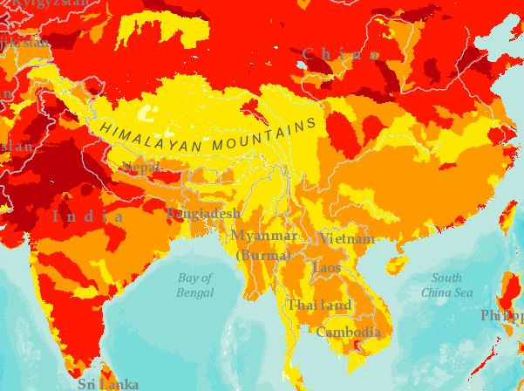


Valuation of Water Scarcity and Quality Risks
Addressing water constraints to growth:
INCORPORATE a risk-adjusted cost of water
MAKE THE CASE for proactive water management strategies
IDENTIFY operations/locations at greatest risk
MONETIZE rate of return for water management improvement projects
SELECT where and how to increase capacity to meet demand in new regions
Shanghai
New Delhi
Hong Kong
Incoming Water Price ($ per m³)
Bangkok
Incoming Risk-Adjusted Water Price ($ per m³)
Outgoing Water Price ($ per m³)
Outgoing Risk-Adjusted Water Price ($ per m³)
Map Filter: Overall Water Risk
New Delhi hotel
Bangkok hotel
Hong Kong hotel
Shanghai hotel
INCOMING
OUTGOING
INCOMING
OUTGOING
INCOMING
OUTGOING
INCOMING
OUTGOING

Slide 10
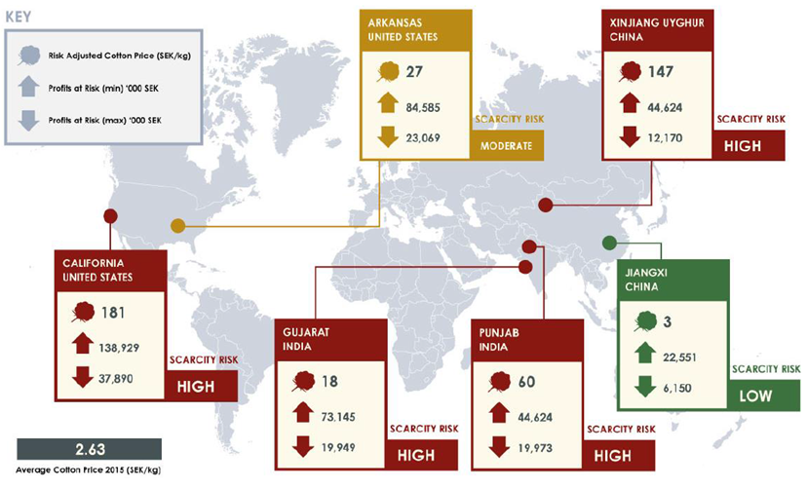
Commodity Environmental Risk and Profit at Risk
Source: Trucost Analysis

Slide 11
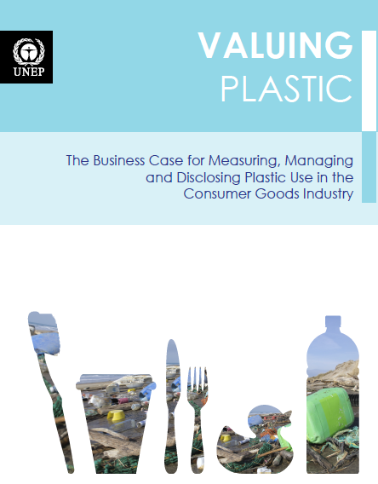

Environmental Costs of Plastic
Source: UNEP, Valuing Plastic, 2014. http://www.trucost.com/publication/valuing-plastic/

Slide 12

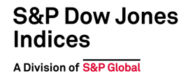
Thank you
Brian Werner
Associate Director | Trucost
55 Water Street
New York, New York
T +1.215.970.3083
brian.werner@spglobal.com

Slide 13
DISCLAIMER
Copyright © 2017 S&P Trucost Limited. Redistribution or reproduction in whole or in part is prohibited without written permission.
This document does not constitute an offer of services in jurisdictions where Trucost and its affiliates do not have the necessary licenses. Trucost is not an investment advisor, and Trucost makes no representation regarding the advisability of investing in any company, security, investment fund or other investment vehicle. A decision to invest in any company, security, investment fund or other investment vehicle should not be made in reliance on any of the statements set forth in this document. Prospective investors are advised to make an investment in any company, security, fund or other vehicle only after carefully considering the risks associated with investing in such funds, as detailed in an offering memorandum or similar document that is prepared by or on behalf of the issuer of the investment fund or other investment product or vehicle.
The materials have been prepared solely for informational purposes only based upon information generally available to the public from sources believed to be reliable. No content contained in these materials (including credit-related analyses and data, research, valuation, models, software or other application or output therefrom) or any part thereof (“Content”) may be modified reverse-engineered, reproduced or distributed in any form or by any means, or stored in a database or retrieval system, without the prior written permission of Trucost. The Content shall not be used for any unlawful or unauthorized purposes. Trucost, its parent S&P Dow Jones Indices LLC and its third-party data providers and licensors (collectively the “Trucost Parties”) do not guarantee the accuracy, completeness, timeliness or availability of the Content. Trucost Parties are not responsible for any errors or omissions, regardless of the cause, for the results obtained from the use of the Content. THE CONTENT IS PROVIDED ON AN “AS IS” BASIS. TRUCOST PARTIES DISCLAIM ANY AND ALL EXPRESS OR IMPLIED WARRANTIES, INCLUDING, BUT NOT LIMITED TO, ANY WARRANTIES OF MERCHANTABILITY OR FITNESS FOR A PARTICULAR PURPOSE OR USE, FREEDOM FROM BUGS, SOFTWARE ERRORS OR DEFECTS, THAT THE CONTENT’S FUNCTIONING WILL BE UNINTERRUPTED OR THAT THE CONTENT WILL OPERATE WITH ANY SOFTWARE OR HARDWARE CONFIGURATION. In no event shall any of the Trucost Parties be liable to any party for any direct, indirect, incidental, exemplary, compensatory, punitive, special or consequential damages, costs, expenses, legal fees, or losses (including, without limitation, lost income or lost profits and opportunity costs) in connection with any use of the Content even if advised of the possibility of such damages.
The Content does not constitute or form part of any offer, invitation to sell, offer to subscribe for or to purchase any shares or other securities and must not be relied upon in connection with any contract relating to any such matter. ‘Trucost’ is the trading name of S&P Trucost Limited a limited company registered in England company number 3929223 whose registered office is at 20 Canada Square, London E14 5HL, UK.

Slide 14
S&P DOW JONES INDICES GENERAL DISCLAIMER
Copyright © 2017 S&P Dow Jones Indices LLC, a division of S&P Global. All rights reserved. STANDARD & POOR’S, S&P, S&P 500, S&P 500 LOW VOLATILITY INDEX, S&P 100, S&P COMPOSITE 1500, S&P MIDCAP 400, S&P SMALLCAP 600, S&P GIVI, GLOBAL TITANS, DIVIDEND ARISTOCRATS, S&P TARGET DATE INDICES, GICS, SPIVA, SPDR and INDEXOLOGY are registered trademarks of Standard & Poor’s Financial Services LLC, a division of S&P Global (“S&P”). DOW JONES, DJ, DJIA and DOW JONES INDUSTRIAL AVERAGE are registered trademarks of Dow Jones Trademark Holdings LLC (“Dow Jones”). These trademarks together with others have been licensed to S&P Dow Jones Indices LLC. Redistribution or reproduction in whole or in part are prohibited without written permission of S&P Dow Jones Indices LLC. This document does not constitute an offer of services in jurisdictions where S&P Dow Jones Indices LLC, S&P, Dow Jones or their respective affiliates (collectively “S&P Dow Jones Indices”) do not have the necessary licenses. Except for certain custom index calculation services, all information provided by S&P Dow Jones Indices is impersonal and not tailored to the needs of any person, entity or group of persons. S&P Dow Jones Indices receives compensation in connection with licensing its indices to third parties and providing custom calculation services. Past performance of an index is not an indication or guarantee of future results.
It is not possible to invest directly in an index. Exposure to an asset class represented by an index may be available through investable instruments based on that index. S&P Dow Jones Indices does not sponsor, endorse, sell, promote or manage any investment fund or other investment vehicle that is offered by third parties and that seeks to provide an investment return based on the performance of any index. S&P Dow Jones Indices makes no assurance that investment products based on the index will accurately track index performance or provide positive investment returns. S&P Dow Jones Indices LLC is not an investment advisor, and S&P Dow Jones Indices makes no representation regarding the advisability of investing in any such investment fund or other investment vehicle. A decision to invest in any such investment fund or other investment vehicle should not be made in reliance on any of the statements set forth in this document. Prospective investors are advised to make an investment in any such fund or other vehicle only after carefully considering the risks associated with investing in such funds, as detailed in an offering memorandum or similar document that is prepared by or on behalf of the issuer of the investment fund or other investment product or vehicle. S&P Dow Jones Indices LLC is not a tax advisor. A tax advisor should be consulted to evaluate the impact of any tax-exempt securities on portfolios and the tax consequences of making any particular investment decision. Inclusion of a security within an index is not a recommendation by S&P Dow Jones Indices to buy, sell, or hold such security, nor is it considered to be investment advice. Closing prices for S&P Dow Jones Indices’ US benchmark indices are calculated by S&P Dow Jones Indices based on the closing price of the individual constituents of the index as set by their primary exchange. Closing prices are received by S&P Dow Jones Indices from one of its third party vendors and verified by comparing them with prices from an alternative vendor. The vendors receive the closing price from the primary exchanges. Real-time intraday prices are calculated similarly without a second verification].

Slide 15
These materials have been prepared solely for informational purposes based upon information generally available to the public and from sources believed to be reliable. No content contained in these materials (including index data, ratings, credit-related analyses and data, research, valuations, model, software or other application or output therefrom) or any part thereof (“Content”) may be modified, reverse-engineered, reproduced or distributed in any form or by any means, or stored in a database or retrieval system, without the prior written permission of S&P Dow Jones Indices. The Content shall not be used for any unlawful or unauthorized purposes. S&P Dow Jones Indices and its third-party data providers and licensors (collectively “S&P Dow Jones Indices Parties”) do not guarantee the accuracy, completeness, timeliness or availability of the Content. S&P Dow Jones Indices Parties are not responsible for any errors or omissions, regardless of the cause, for the results obtained from the use of the Content. THE CONTENT IS PROVIDED ON AN “AS IS” BASIS. S&P DOW JONES INDICES PARTIES DISCLAIM ANY AND ALL EXPRESS OR IMPLIED WARRANTIES, INCLUDING, BUT NOT LIMITED TO, ANY WARRANTIES OF MERCHANTABILITY OR FITNESS FOR A PARTICULAR PURPOSE OR USE, FREEDOM FROM BUGS, SOFTWARE ERRORS OR DEFECTS, THAT THE CONTENT’S FUNCTIONING WILL BE UNINTERRUPTED OR THAT THE CONTENT WILL OPERATE WITH ANY SOFTWARE OR HARDWARE CONFIGURATION. In no event shall S&P Dow Jones Indices Parties be liable to any party for any direct, indirect, incidental, exemplary, compensatory, punitive, special or consequential damages, costs, expenses, legal fees, or losses (including, without limitation, lost income or lost profits and opportunity costs) in connection with any use of the Content even if advised of the possibility of such damages.
S&P Global keeps certain activities of its various divisions and business units separate from each other in order to preserve the independence and objectivity of their respective activities. As a result, certain divisions and business units of S&P Global may have information that is not available to other business units. S&P Global has established policies and procedures to maintain the confidentiality of certain non-public information received in connection with each analytical process.
In addition, S&P Dow Jones Indices provides a wide range of services to, or relating to, many organizations, including issuers of securities, investment advisers, broker-dealers, investment banks, other financial institutions and financial intermediaries, and accordingly may receive fees or other economic benefits from those organizations, including organizations whose securities or services they may recommend, rate, include in model portfolios, evaluate or otherwise address.

